Slide 1
Week 10 class 1: disinformation data analysis
INST408C: Cognitive Security | Fall 2021 | SJ Terp

Slide 2
INST408C Week
Monday
Network analysis: theory
Wednesday
Network analysis: practice
Readings
Assignments
Gephi network analysis of a dataset of your own choice
Notes:
Links:

Slide 3
Context analysis

Slide 4
Recap: (Some) Tactical Tasks
Credibility/ Verification
Fact-checking: verify article, image, video etc doesn’t contain disinformation.
Source-checking: verify source (publisher, domain etc) doesn’t distribute disinformation.
Network detection
Pinkslime finding: find inauthentic website networks
Network finding: find inauthentic account networks (including botnets)
Activity analysis
Detect computational amplification
Detect fake accounts
Look at patterns of account creation dates for popular messages
Detect, track and analyse narratives
Notes:
Fact-checking is hard, and usually needs a team of fact-checkers, up-to-date knowledge etc.
Source-checking: This is why we label and track URLs. Several groups already publish labelled lists of domains.
Source networks: Some work on “pink slime” exists.

Slide 5
Context analysis
Social network analysis
Mapping and measuring relationships and information flows between people, groups, URLs, and other information entities.
Techniques and tools for assessing the relationships between disinformation artifacts, narratives, and other incident objects.

Slide 6
RECAP: Social network analysis

Slide 7
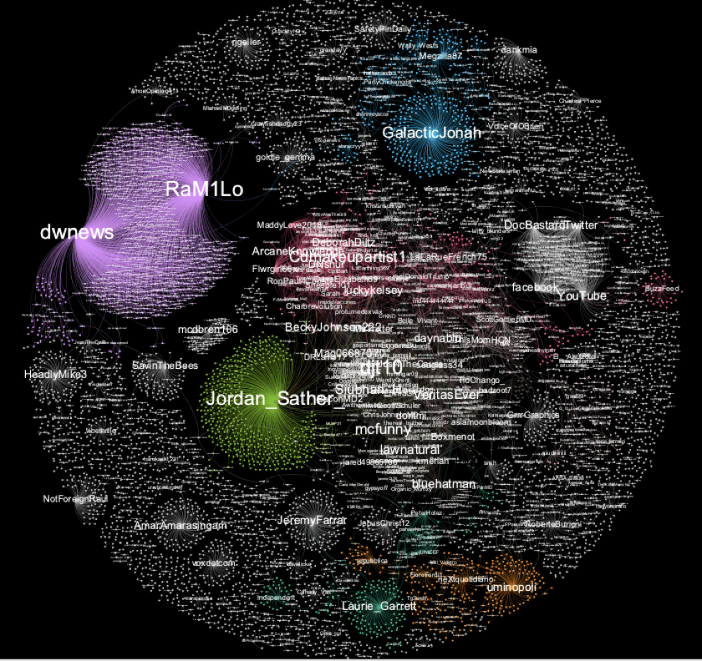
Activities
Understand structure & relationships
Get data
Find relationships in data
Convert to graph
Find structures in graph
Interpret structures
Bonus: monitor results of actions
Take action
Analyse structures
Adapt actions

Slide 8
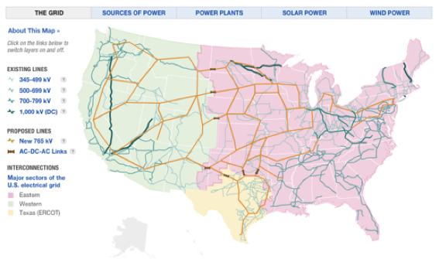
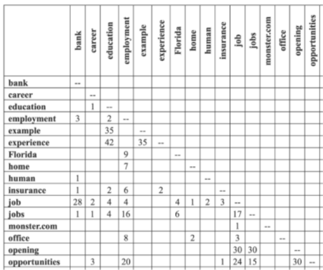
Relationships
Social media accounts
Hashtags
URLs
Images
Text
Documents
Groups
...

Slide 9
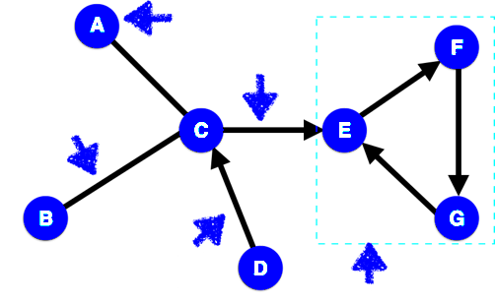
Relationships as Networks
Node
Edge
Undirected edge
4
Tie strength
Directed edge
Clique
Notes:
We’re going to be dealing with simple networks. These each have features, that we need to be able to name.
Node: object in the network (e.g. two people)
Edge: link between two objects (e.g. a friendship)
Directed edge: link for a relationship that just goes one way (e.g. a ‘friends’ b, but b doesn’t ‘friend’ a).
Clique: set of nodes where every node in the clique is connected every other node in the clique.
Tie strength: https://www.nature.com/articles/s41598-018-27290-8

Slide 10
Network analysis
Analysis tools
Gephi does this. In Python, NetworkX is simple to use
Analysis questions
Centrality: how important is each node to the network?
Community detection: what type of groups are there in this network?
Transmission: how might (information, disease, etc) move across this network?
Network characteristics: what type of network do we have here?
Network properties:
Characteristic path length: average shortest distance between all pairs of nodes
Clustering coefficient: how likely a network is to contain highly-connected groups
Degree distribution: histogram of node degrees
Disconnection
(scale-free networks)
And also
Overlapping community detection (modularity etc)
Homophily (how node dissimilarity affects networks)
Graph cohesion (which nodes strengthen or weaken a network)
Graph skeletons (e.g. minimum spanning trees)
Marketing metrics (reach etc)

Slide 11
Centralities
Degree centrality: who has lots of friends
Betweenness centrality: who are the bridges
Closeness centrality: who are the hubs
Eigenvalue centrality: who has most influence
Notes:
Eigenvector centrality measures how much influence a node has in the whole network, taking account of their connections to other highly-connected nodes. These are the “kings” of your network - they might not have great closeness or betweenness, but they do wield a lot of influence. The algorithm behind Google search, PageRank, is based on eigenvector centrality.
NB Eigenvector centrality algorithms are complex, and won’t always give you a solution.

Slide 12
Communities
Communities = groupings within your network.
Useful for questions like
“how is a network likely to split into groups” and
“how do I efficiently influence this network”.
Note that when we have a community, we can study it as a network in its own right, including finding the most important nodes in it.
Notes:
“Small world theory” = there are roughly 6 steps on the shortest path between each pair of nodes in the world (see also “6 degrees of Kevin Bacon” http://en.wikipedia.org/wiki/Six_degrees_of_separation). The maths works out at roughly s = ln(n)/ln(k) where n is the population size and k is the average number of connections per node. For k=30, s is usually roughly 6.
NetworkX community functions: http://networkx.lanl.gov/reference/algorithms.community.html

Slide 13
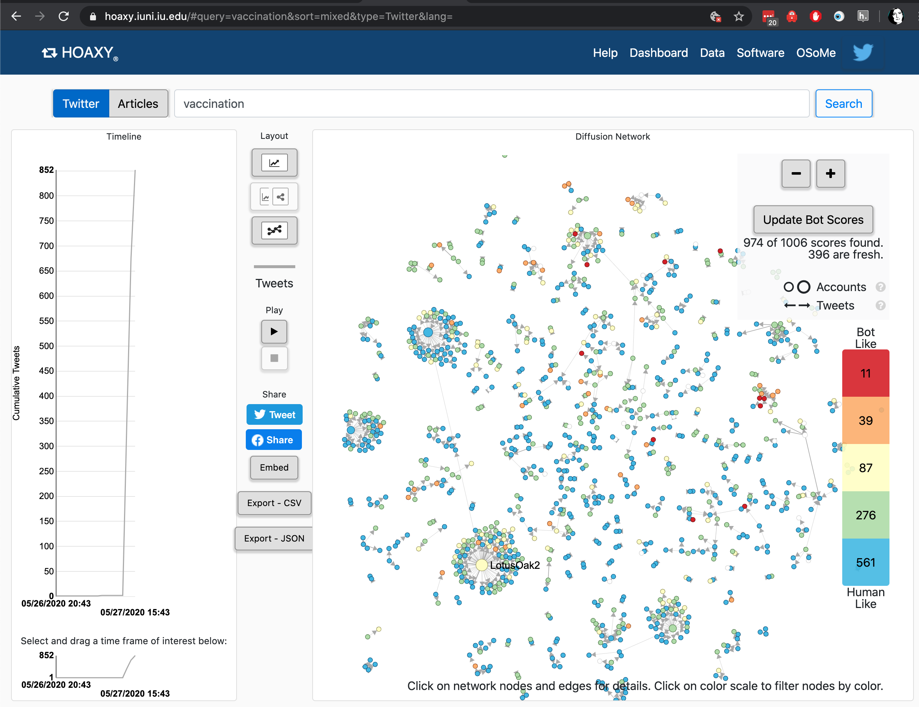
U Indiana data tools
Notes:
https://hoaxy.iuni.iu.edu/#query=vaccination&sort=mixed&type=Twitter&lang=
Hoaxy uses Gephi - we have instructions for how to run twitter through that in the BigBook too.

Slide 14
Network tools

Slide 15
Network Tools
Standalone analysis tools:
Gephi
NodeXL
Cytoscape
(NetMiner)
Neo4J
Standalone visualisation tools:
D3.js
Python analysis libraries:
NetworkX
Python visualisation tools:
Matplotlib
Data conversion
https://medialab.github.io/table2net/
Notes:
Longer list: http://en.wikipedia.org/wiki/Social_network_analysis_software

Slide 16
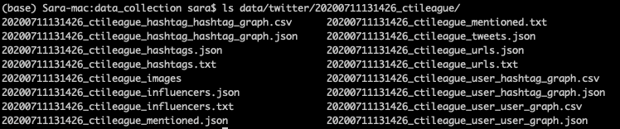
Gephi: get dataset
Get data collection code: https://github.com/cogsec-collaborative/amitt_tracking/blob/master/andypatel_get_data.py
In terminal window, type: “python andypatel_get_data.py ctileague”
This creates a directory with files:
User-user: counts replies, retweets, quotes, mentions
Hashtag-hashtag: counts co-occurrences
User-hashtag: counts hashtag use

Slide 17
Gephi: create graph
Get tool: https://gephi.org/users/download/
Build graph:
Start Gephi. Click on top menu>file>“import spreadsheet”. Grab User_user_graph.csv - use all defaults
Go to data laboratory
Top menu: Go to data laboratory, “copy data to another column”, click ‘id’, click okay.
Go to overview
RHS: Run average weighted degree algorithm
LHS: Select “tt”, ranking, weighted degree, set minsize=0.2, choose 3rd spline, apply
RHS: Run modularity algorithm, using defaults
LHS: Click color icon, then partition, modularity class. Open palette, generate, unclick “limit number of colors”, preset=intense, generate, okay
LHS: Layout: OpenOrd, run. Then forceatlas2, run. Try stronger gravity, and scaling=200
Go to preview
select “black background”, click “refresh”. Click “Reset zoom”

Slide 18
Start here
Need a CSV formatted as (source, target, weight)
Gephi
Import spreadsheet
Source,Target,Weight
007Danger007,gbrough10,1
0_hank3,gbrough10,1
151_gene,gbrough10,1
1969bird,gbrough10,1
1984_christmas,gbrough10,1
1AJBarrett,RollingStone,1
1JasonRodriguez,gbrough10,1
1TRUMPLVR,gbrough10,1
1Taurenraging,gbrough10,1

Slide 19
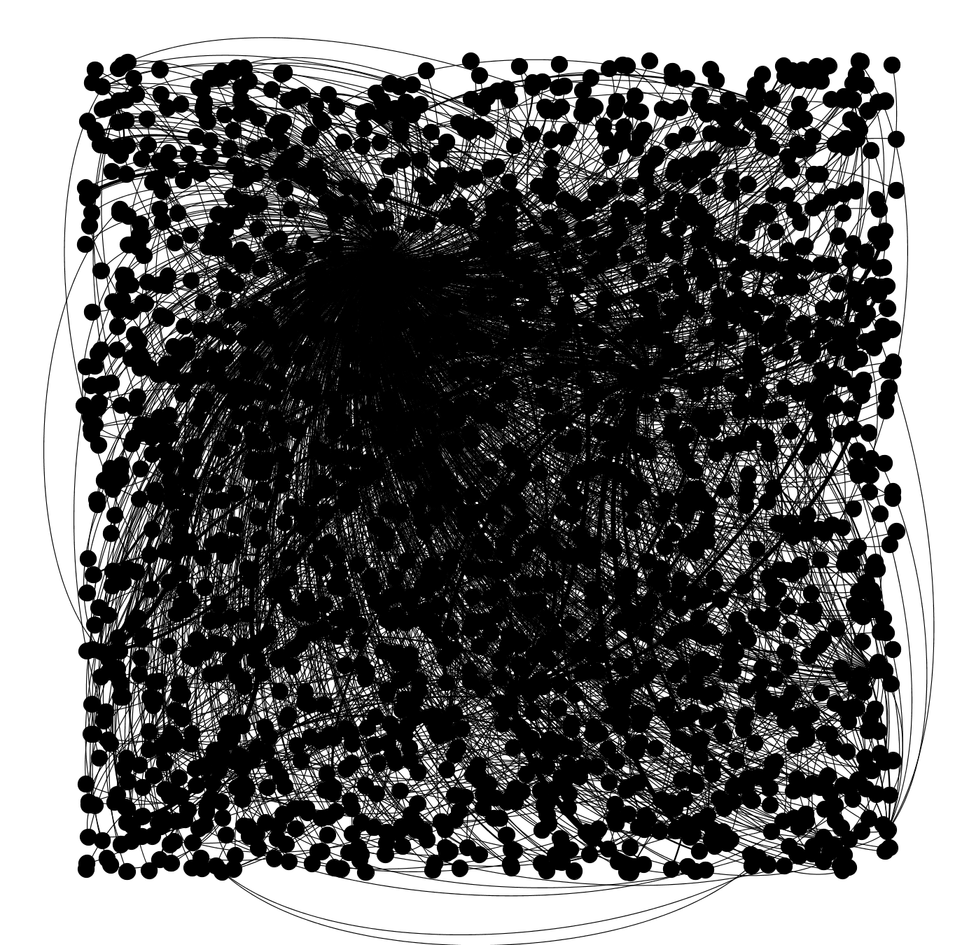
Looks like this

Slide 20
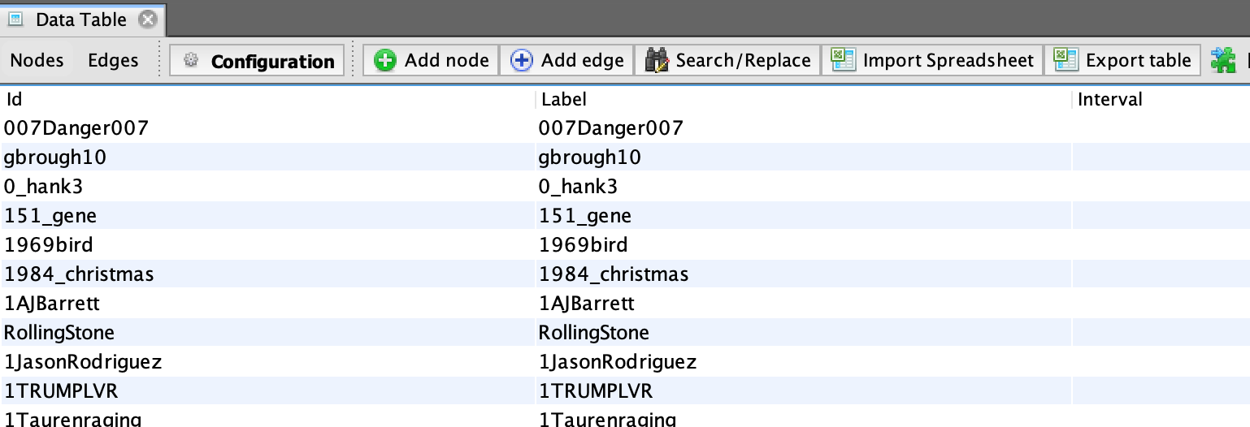
Add labels
Copy ‘id’ column into ‘label’ column

Slide 21
Make label size proportional to degree
RHS: Run average weighted degree algorithm
LHS: Select “tt”, ranking, weighted degree, set minsize=0.2, choose 3rd spline, apply

Slide 22
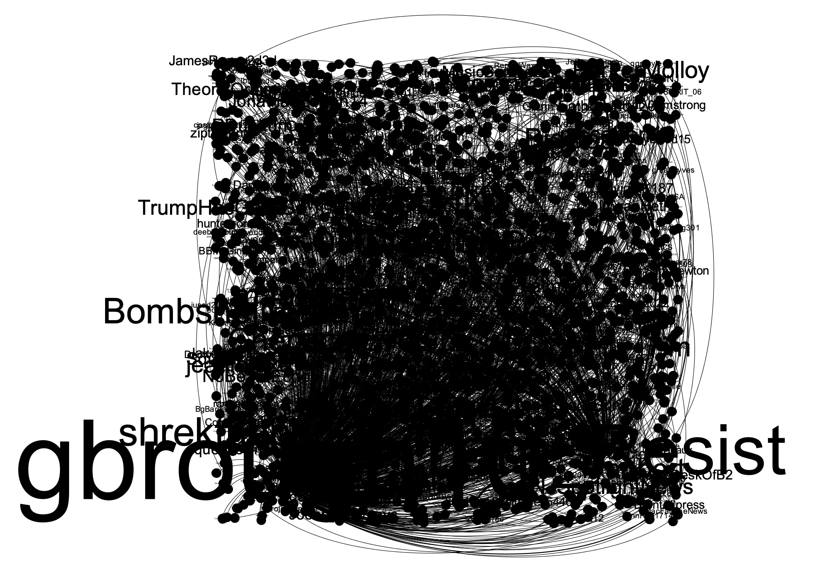
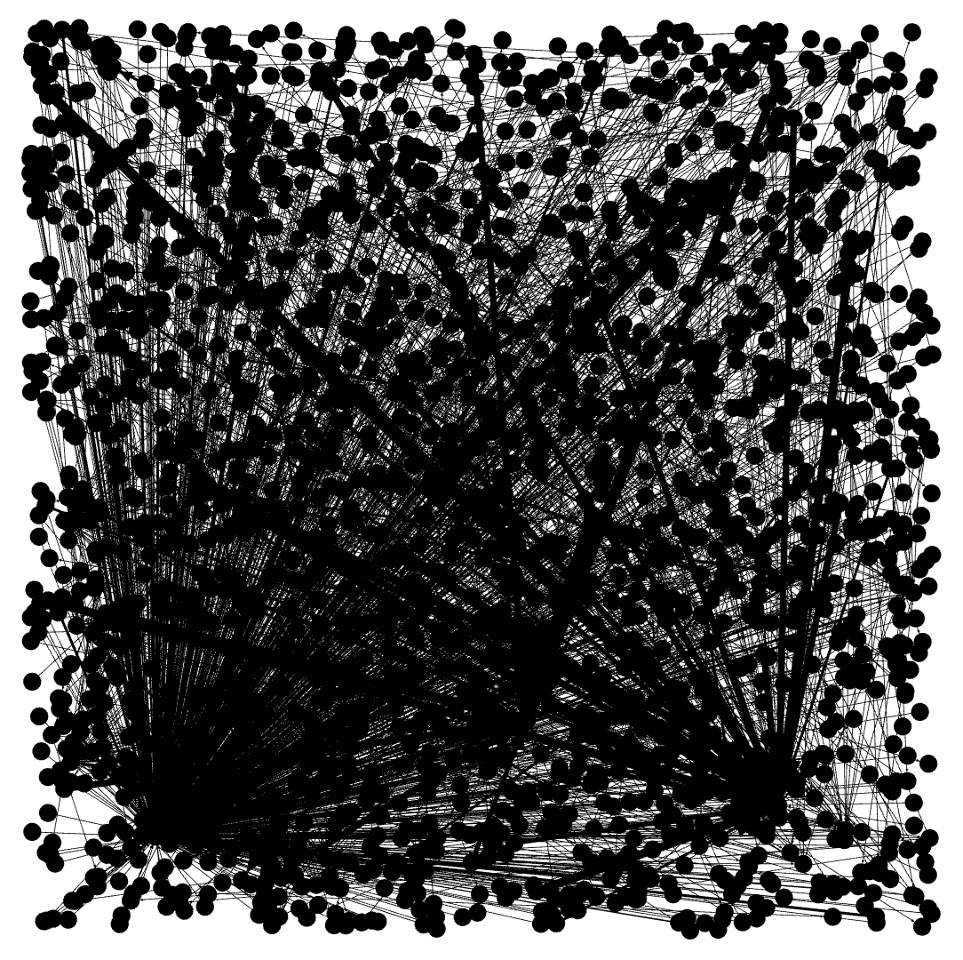
Looks like this
Make sure “show labels” box is ticked

Slide 23
Colour the nodes by community
RHS: Run modularity algorithm, using defaults
LHS: Click color icon, then partition, modularity class. Open palette, generate, unclick “limit number of colors”, preset=intense, generate, okay

Slide 24
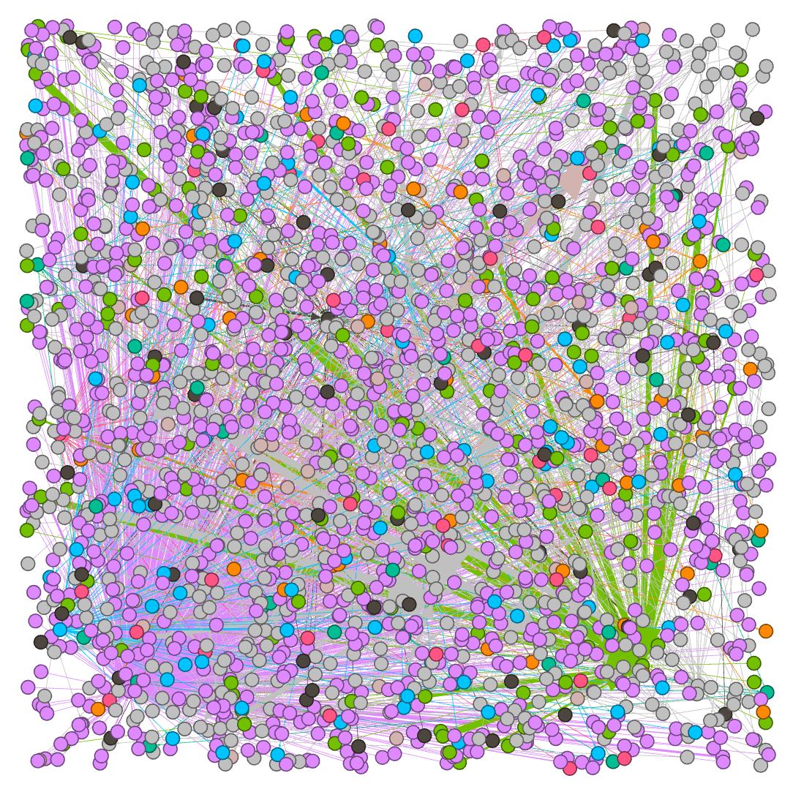
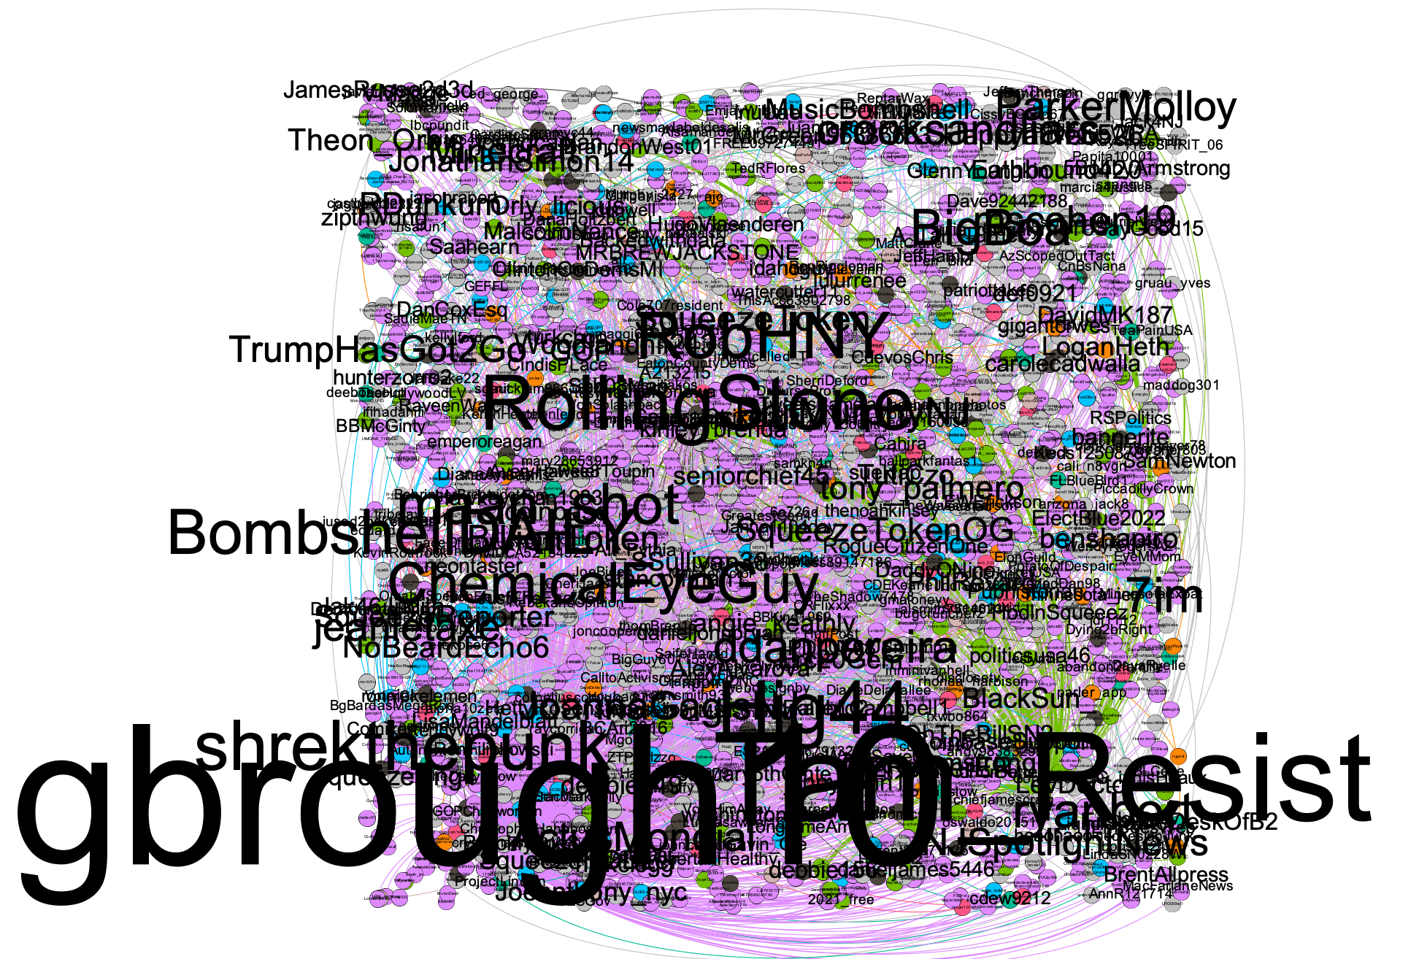
Now looks like this

Slide 25
Clean up the graph layout
LHS: Layout: OpenOrd, run. Then forceatlas2, run. Try stronger gravity, and scaling=200

Slide 26
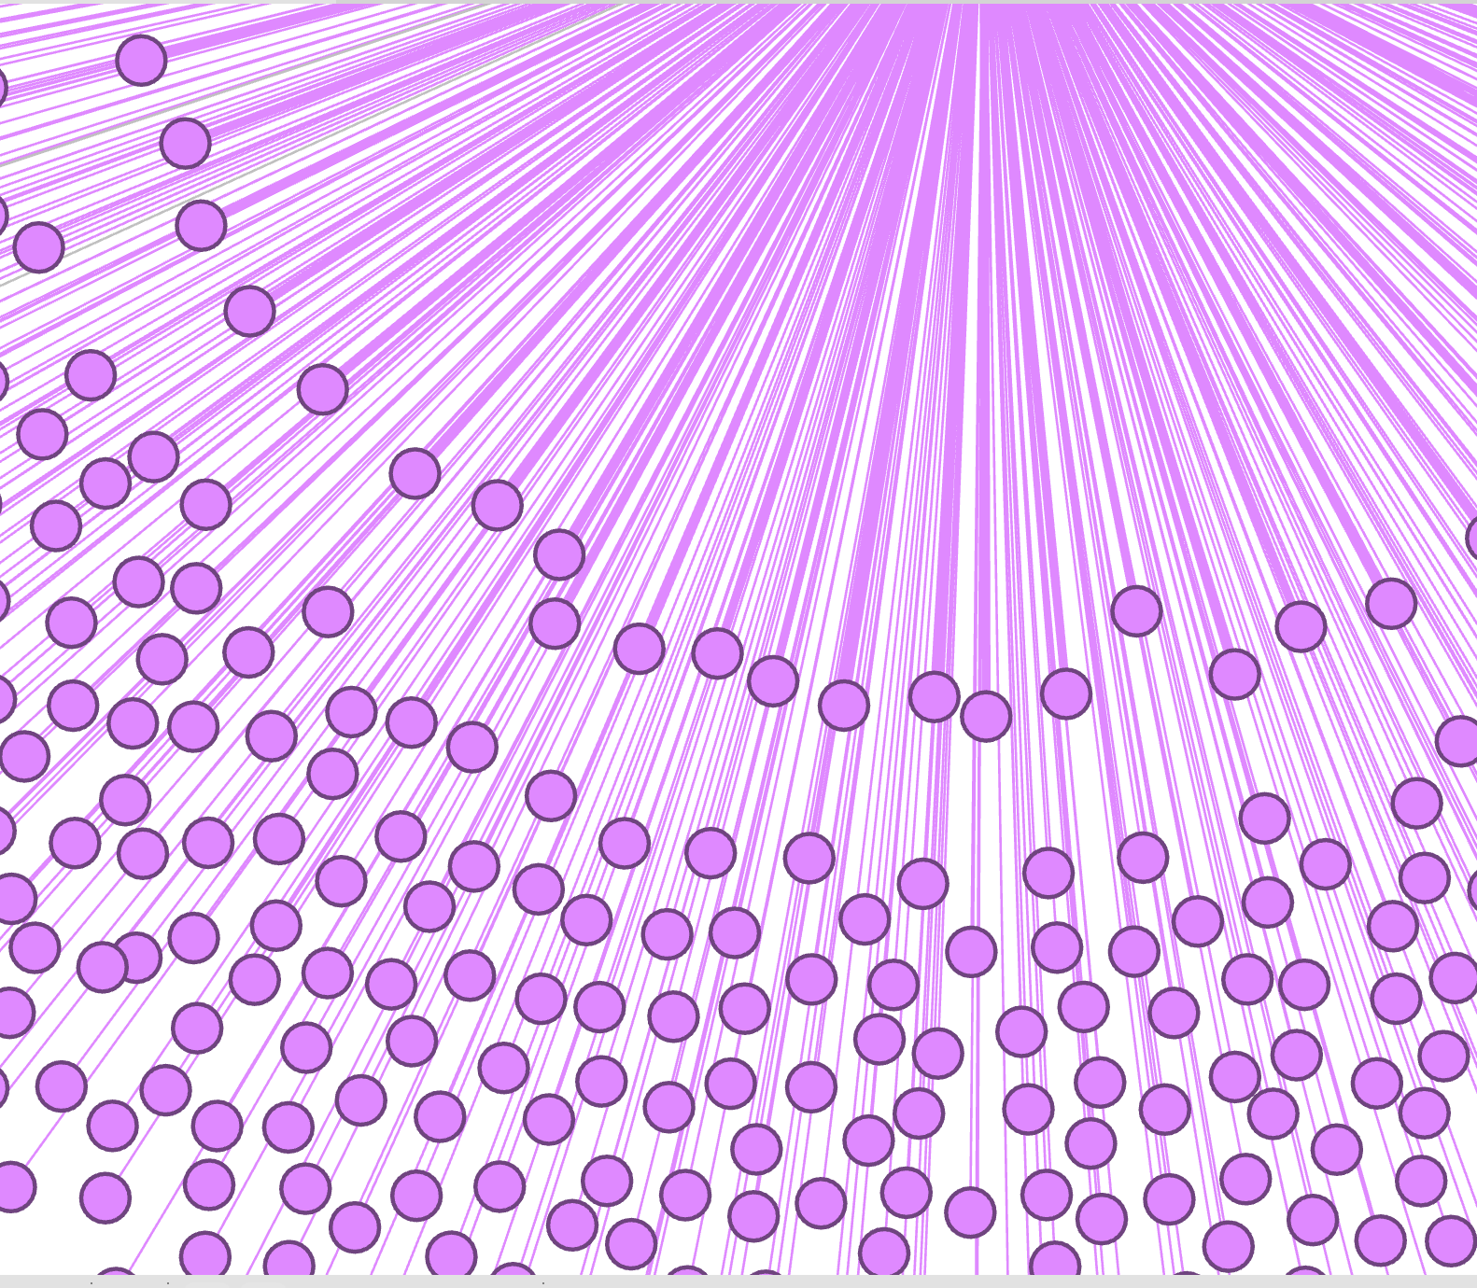
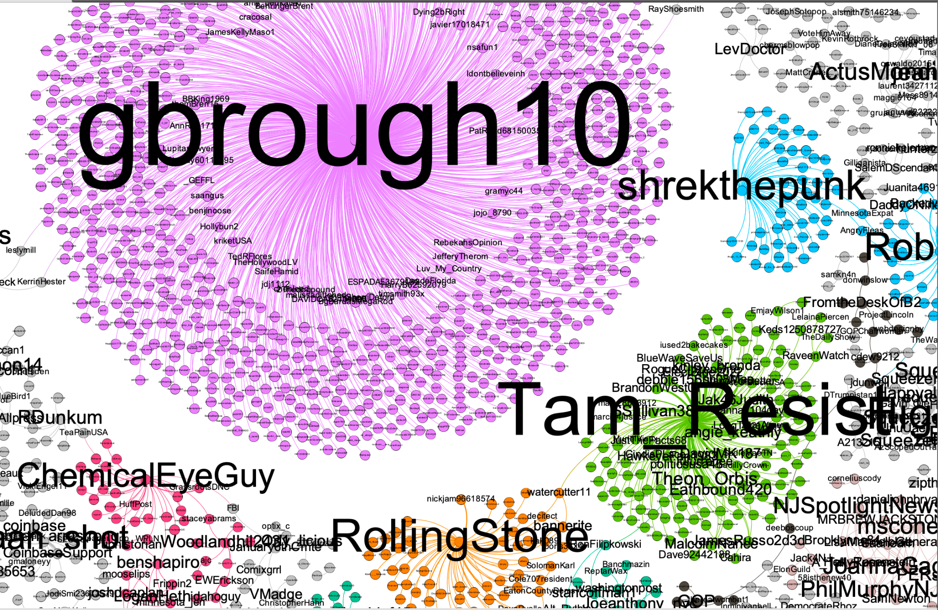
Now looks like this (attempt 1)

Slide 27
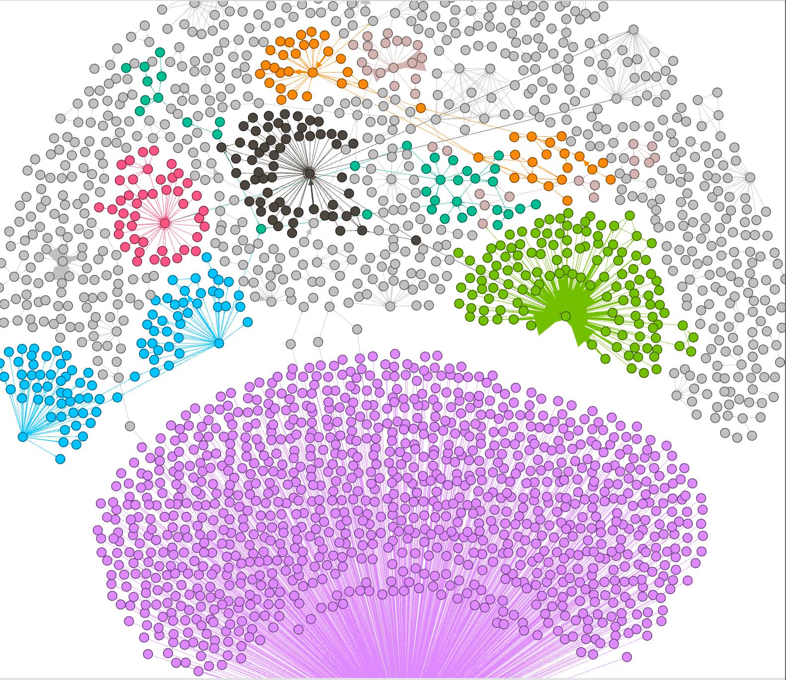
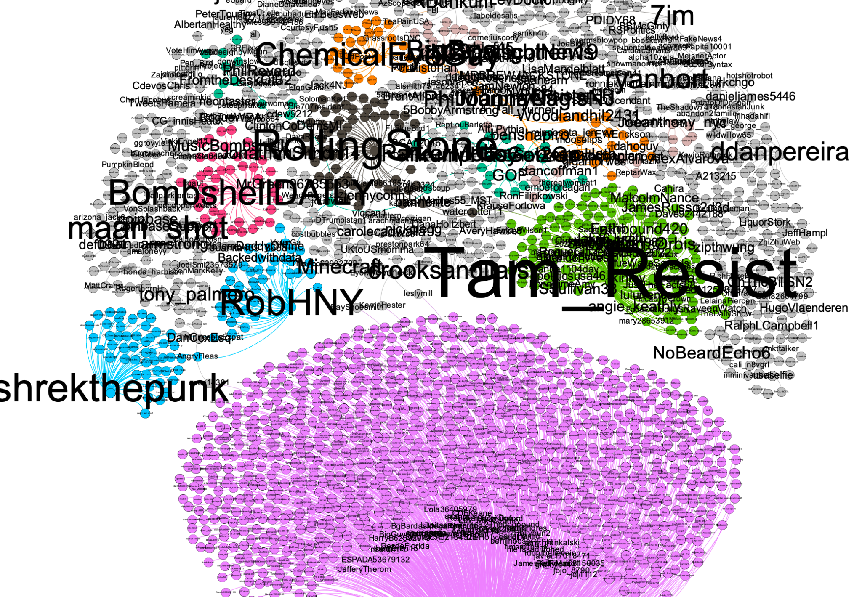
Now looks like this (attempt 2)

Slide 28
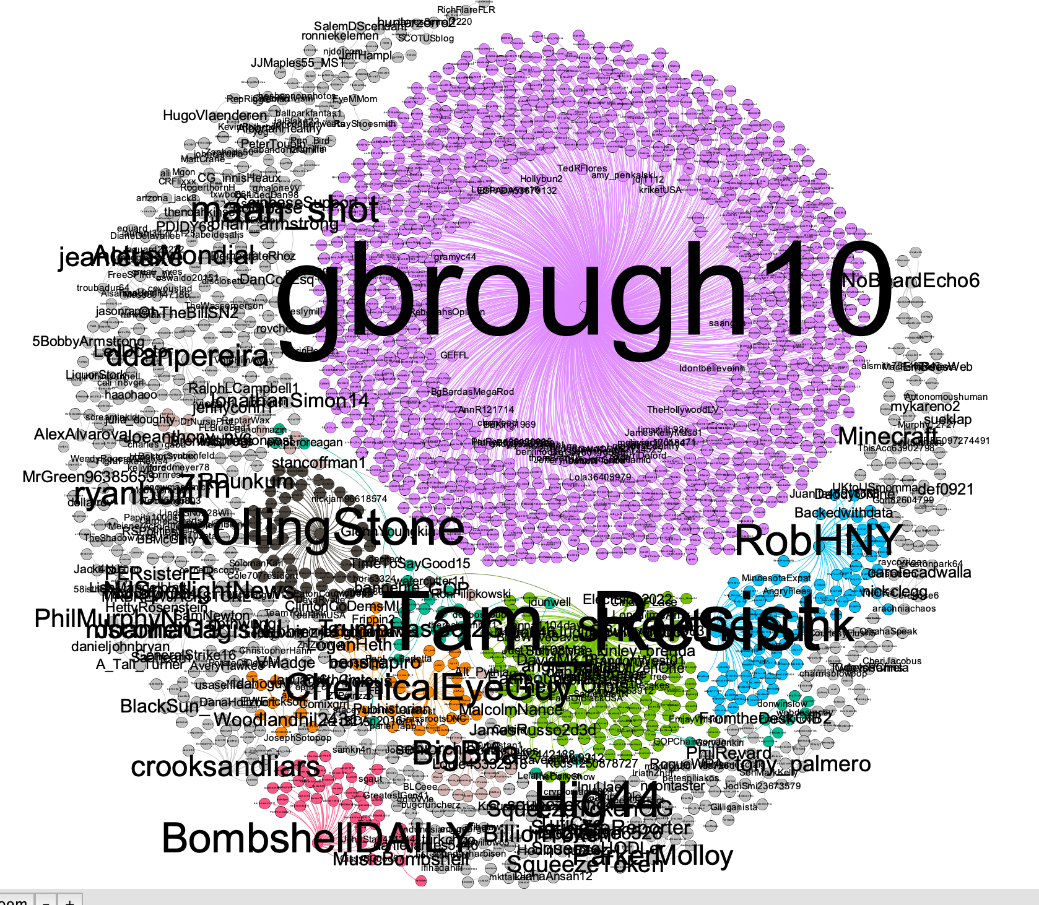
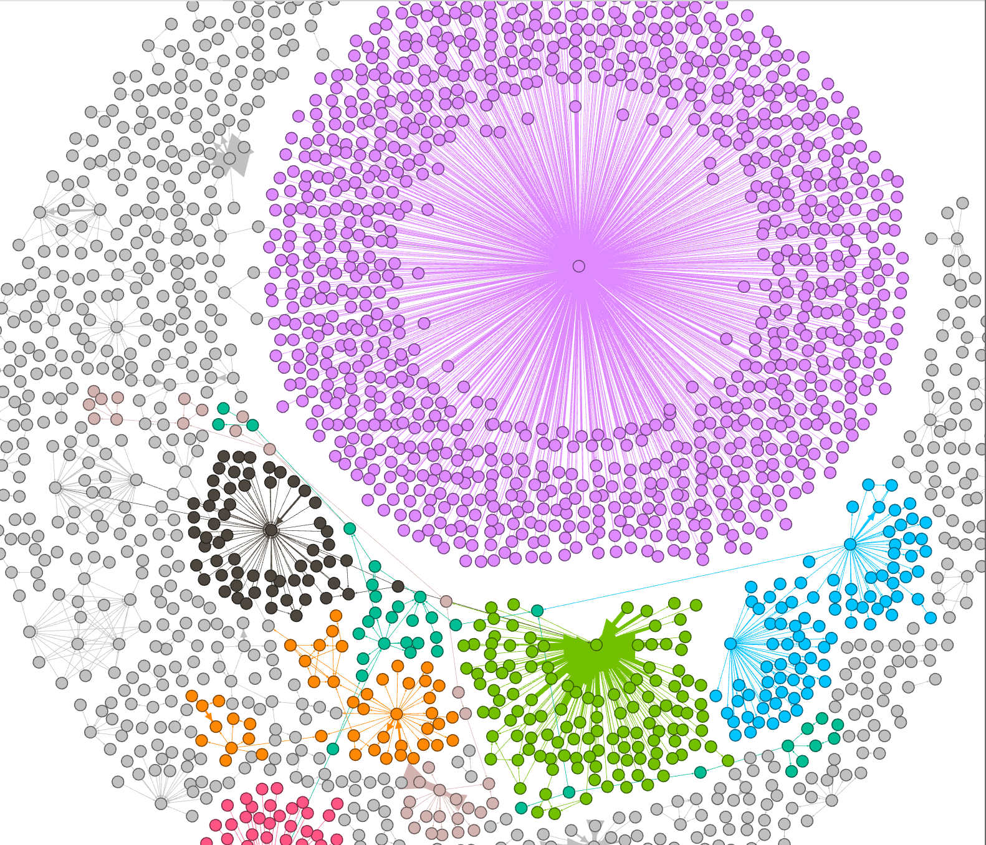
Attempt 3 - running OpenOrd first, then “reset zoom”

Slide 29
Time to clean up a bit
Want white on a black background? Go to preview. select “black background”, click “refresh”. Click “Reset zoom”
Labels are a bit big - try max_size = 4.0
I forgot the rest of the palette (the limit of 8 communities means everything else is greyed out - go back and uncheck “limit number of colors”, then regenerate palette

Slide 30
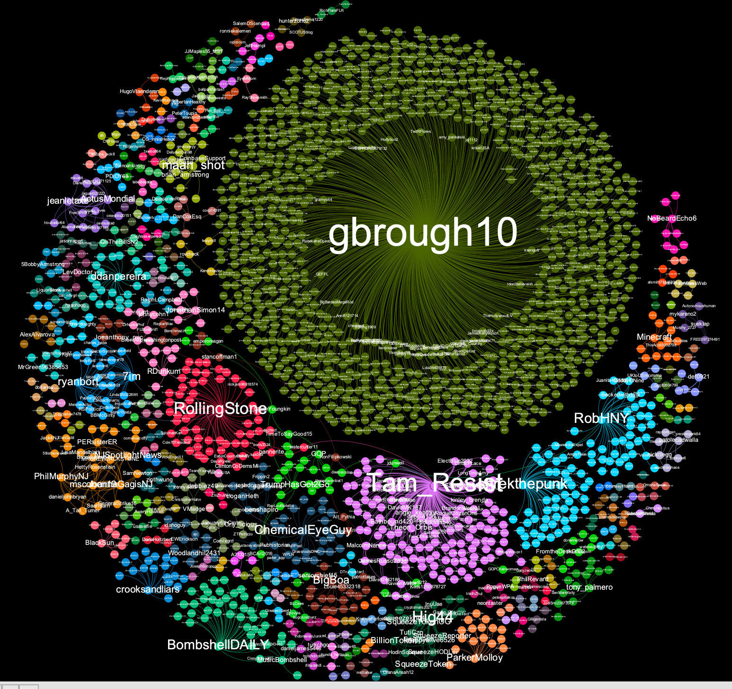
Which gets us to this

Slide 31
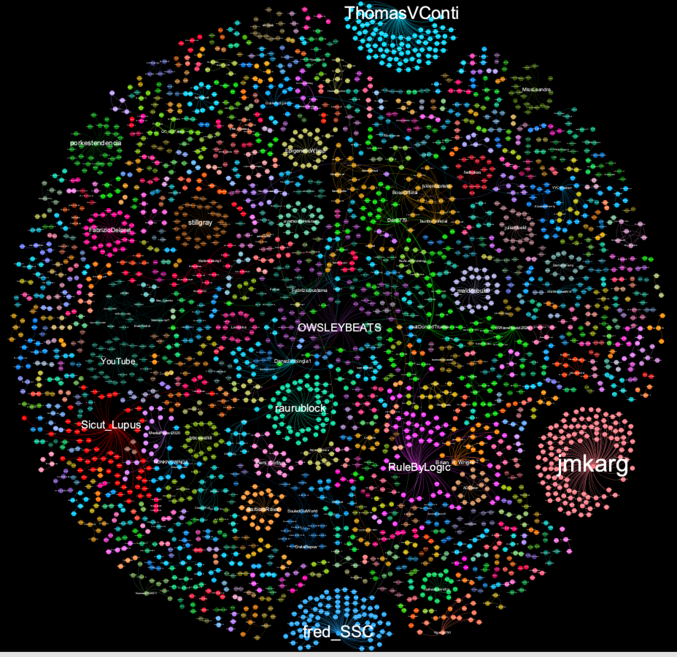
Covid5G
Notes:
Graph: Covid5G

Slide 32
What happens next?
Find the posters and amplifiers: https://www.bellingcat.com/news/2020/05/05/uncovering-a-pro-chinese-government-information-operation-on-twitter-and-facebook-analysis-of-the-milesguo-bot-network/
Investigate creation dates, account descriptions / names, profile images etc (these can also be graphs)
Graph the URLs, images, and accounts mentioned by posters and amplifiers
Notes:
Getting account creation dates: we can use TWeepy for this https://www.geeksforgeeks.org/python-tweepy-getting-the-time-when-a-user-was-created/
(Also cron jobs to check for more data each day… https://towardsdatascience.com/how-to-build-a-dataset-from-twitter-using-python-tweepy-861bdbc16fa5)

Slide 33
Disinformation analysis examples

Slide 34
Useful links
https://firstdraftnews.org/articles/how-to-use-network-analysis-to-explore-social-media-and-disinformation/ and https://benjaminstrick.com/how-i-scrape-and-analyse-twitter-networks/

Slide 35
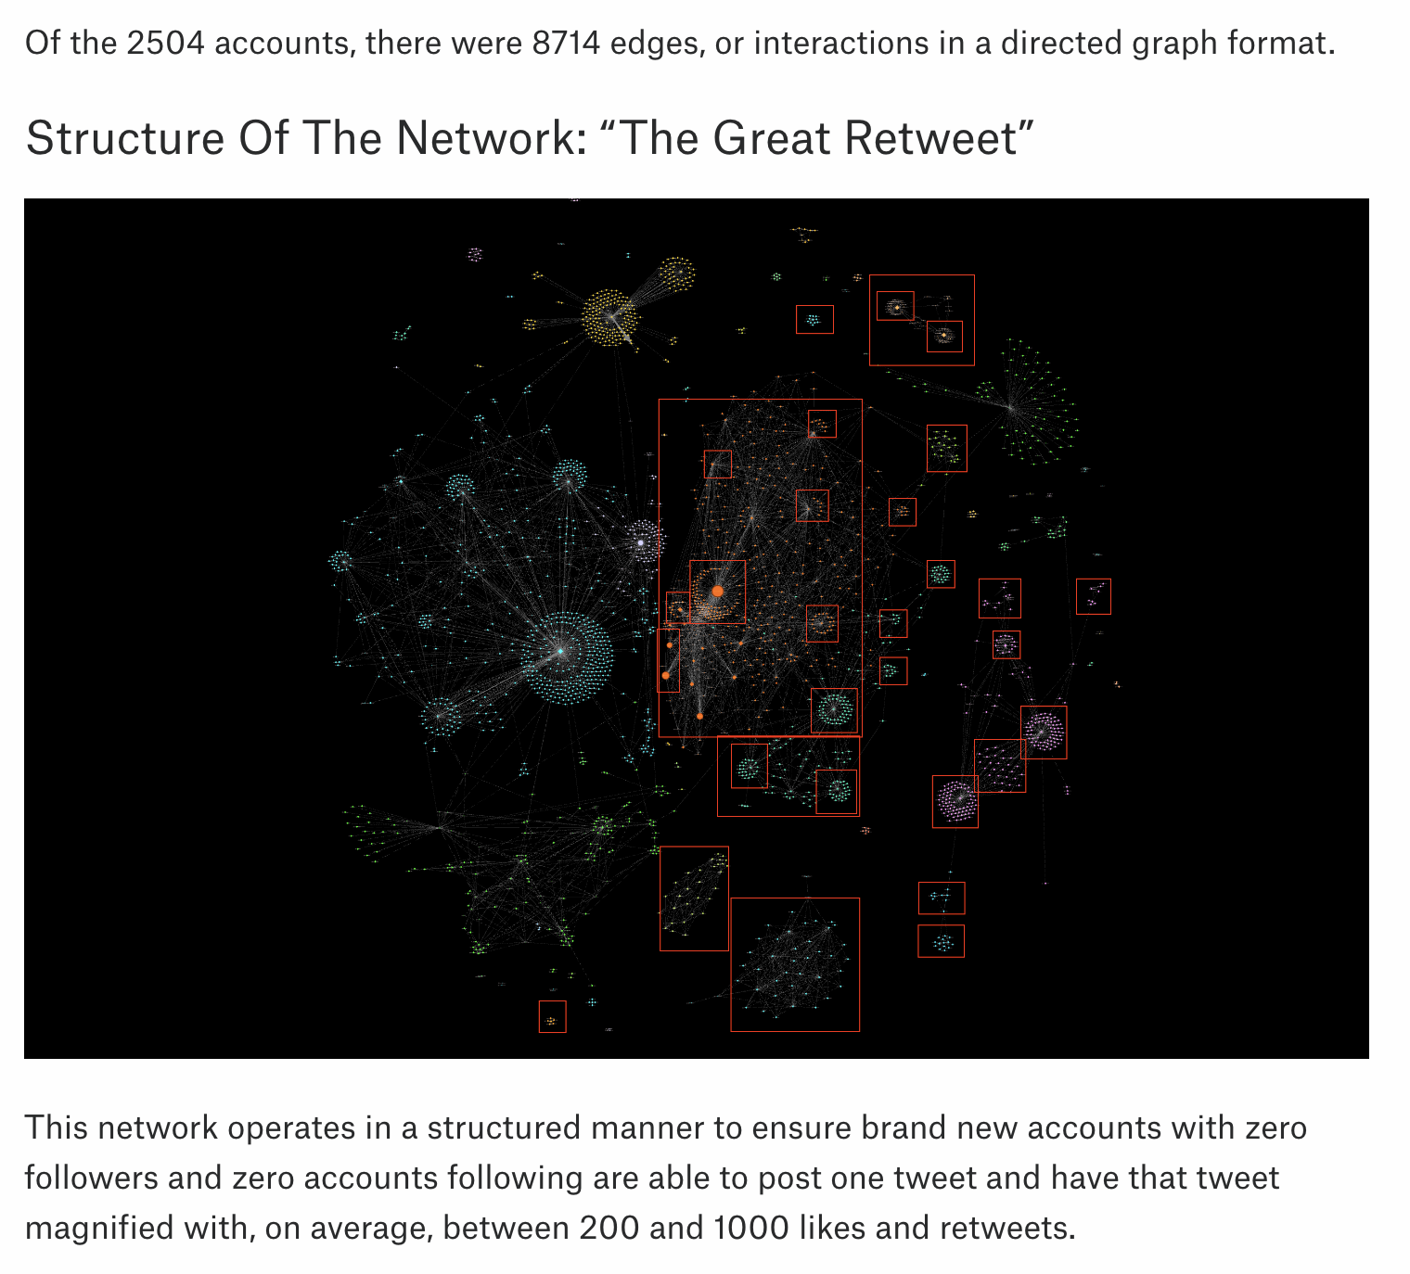
MilesGuo bot
Notes:
https://www.bellingcat.com/news/2020/05/05/uncovering-a-pro-chinese-government-information-operation-on-twitter-and-facebook-analysis-of-the-milesguo-bot-network/

Slide 36
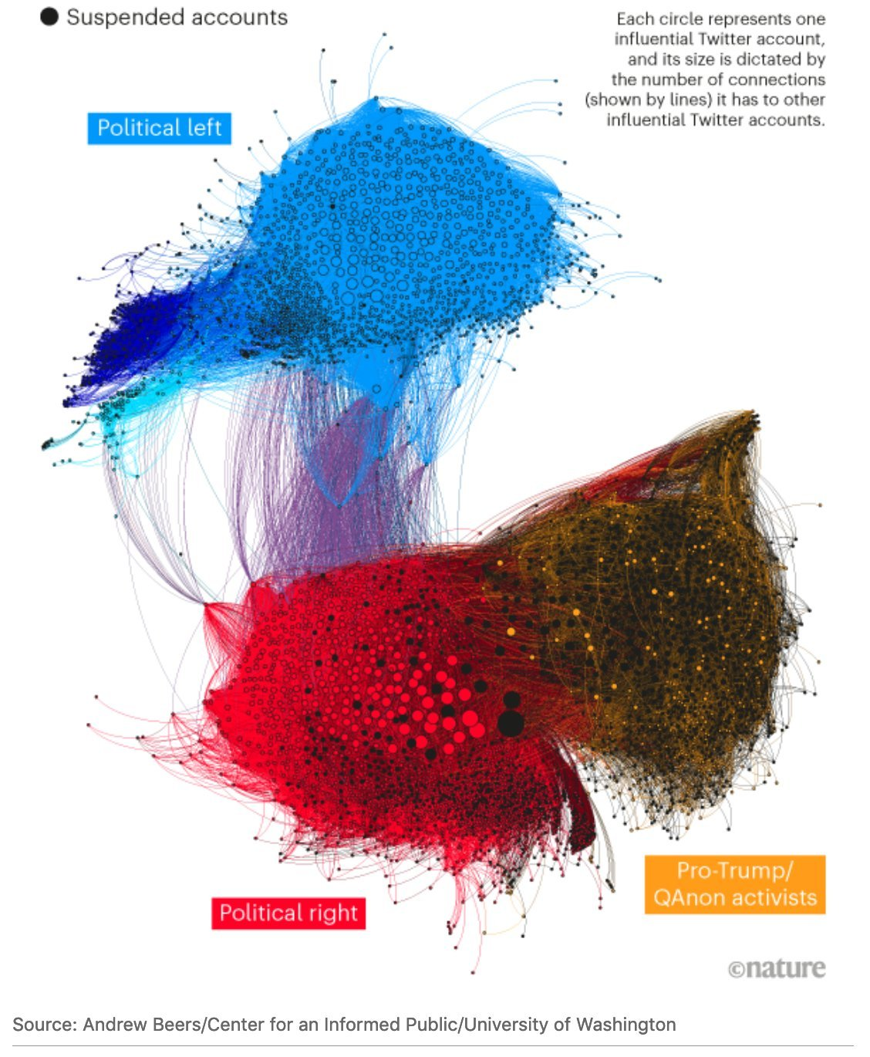
UW on politics
https://twitter.com/beeeeeers/status/1358141547057848320?s=20

Slide 37
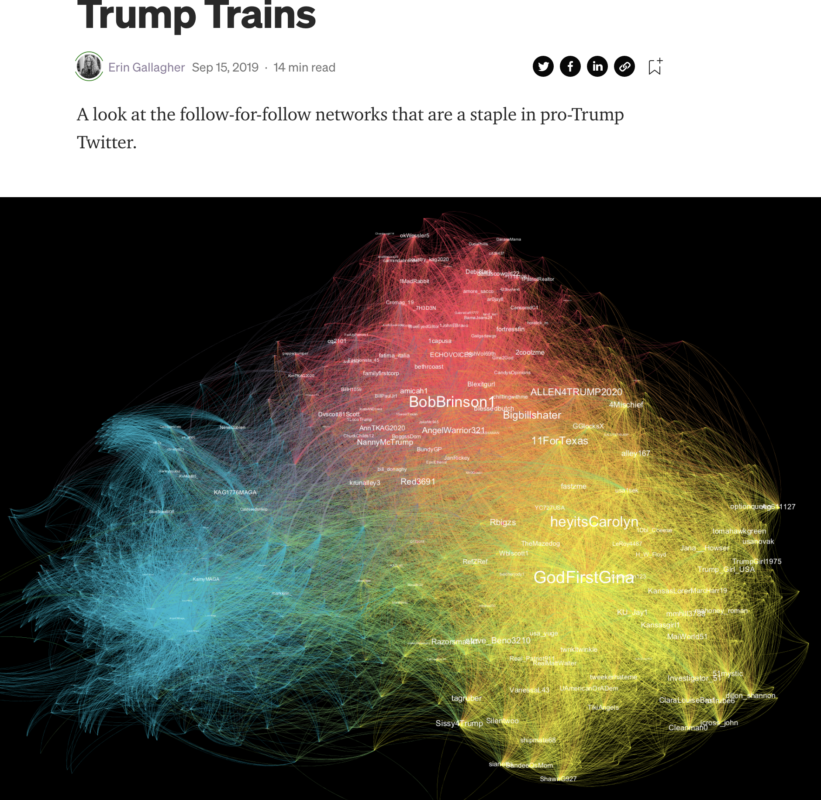
ErinG on Trump Trains
https://erin-gallagher.medium.com/trump-trains-84bea1c3170d

Slide 38
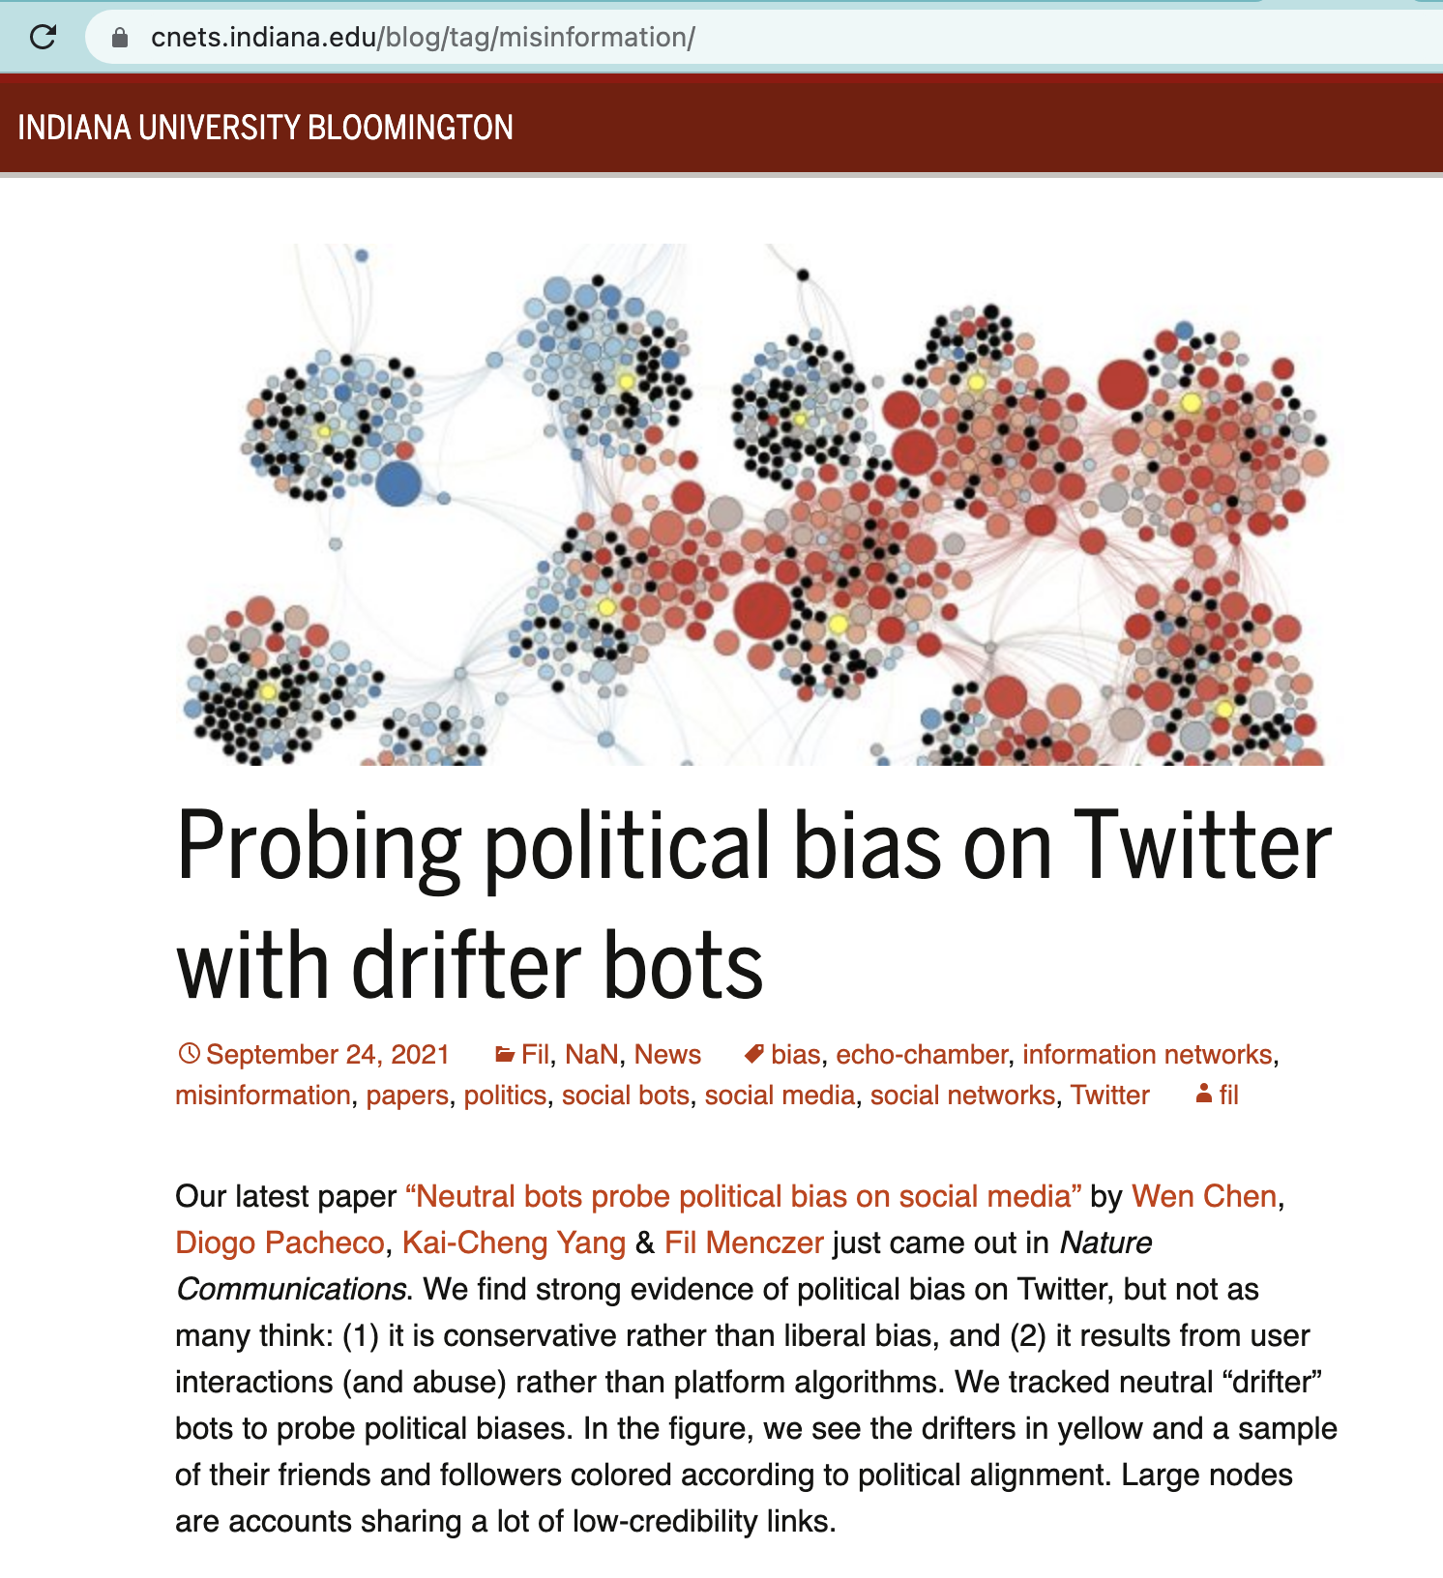
Uni Indiana on “drifter” bots
https://cnets.indiana.edu/blog/2021/09/24/probing-political-bias-on-twitter-with-drifter-bots/#more-9664

Slide 39

BuildUp’s Commons Project
Notes:
https://howtobuildup.org/programs/digital-conflict/the-commons-project/

